Slide 1
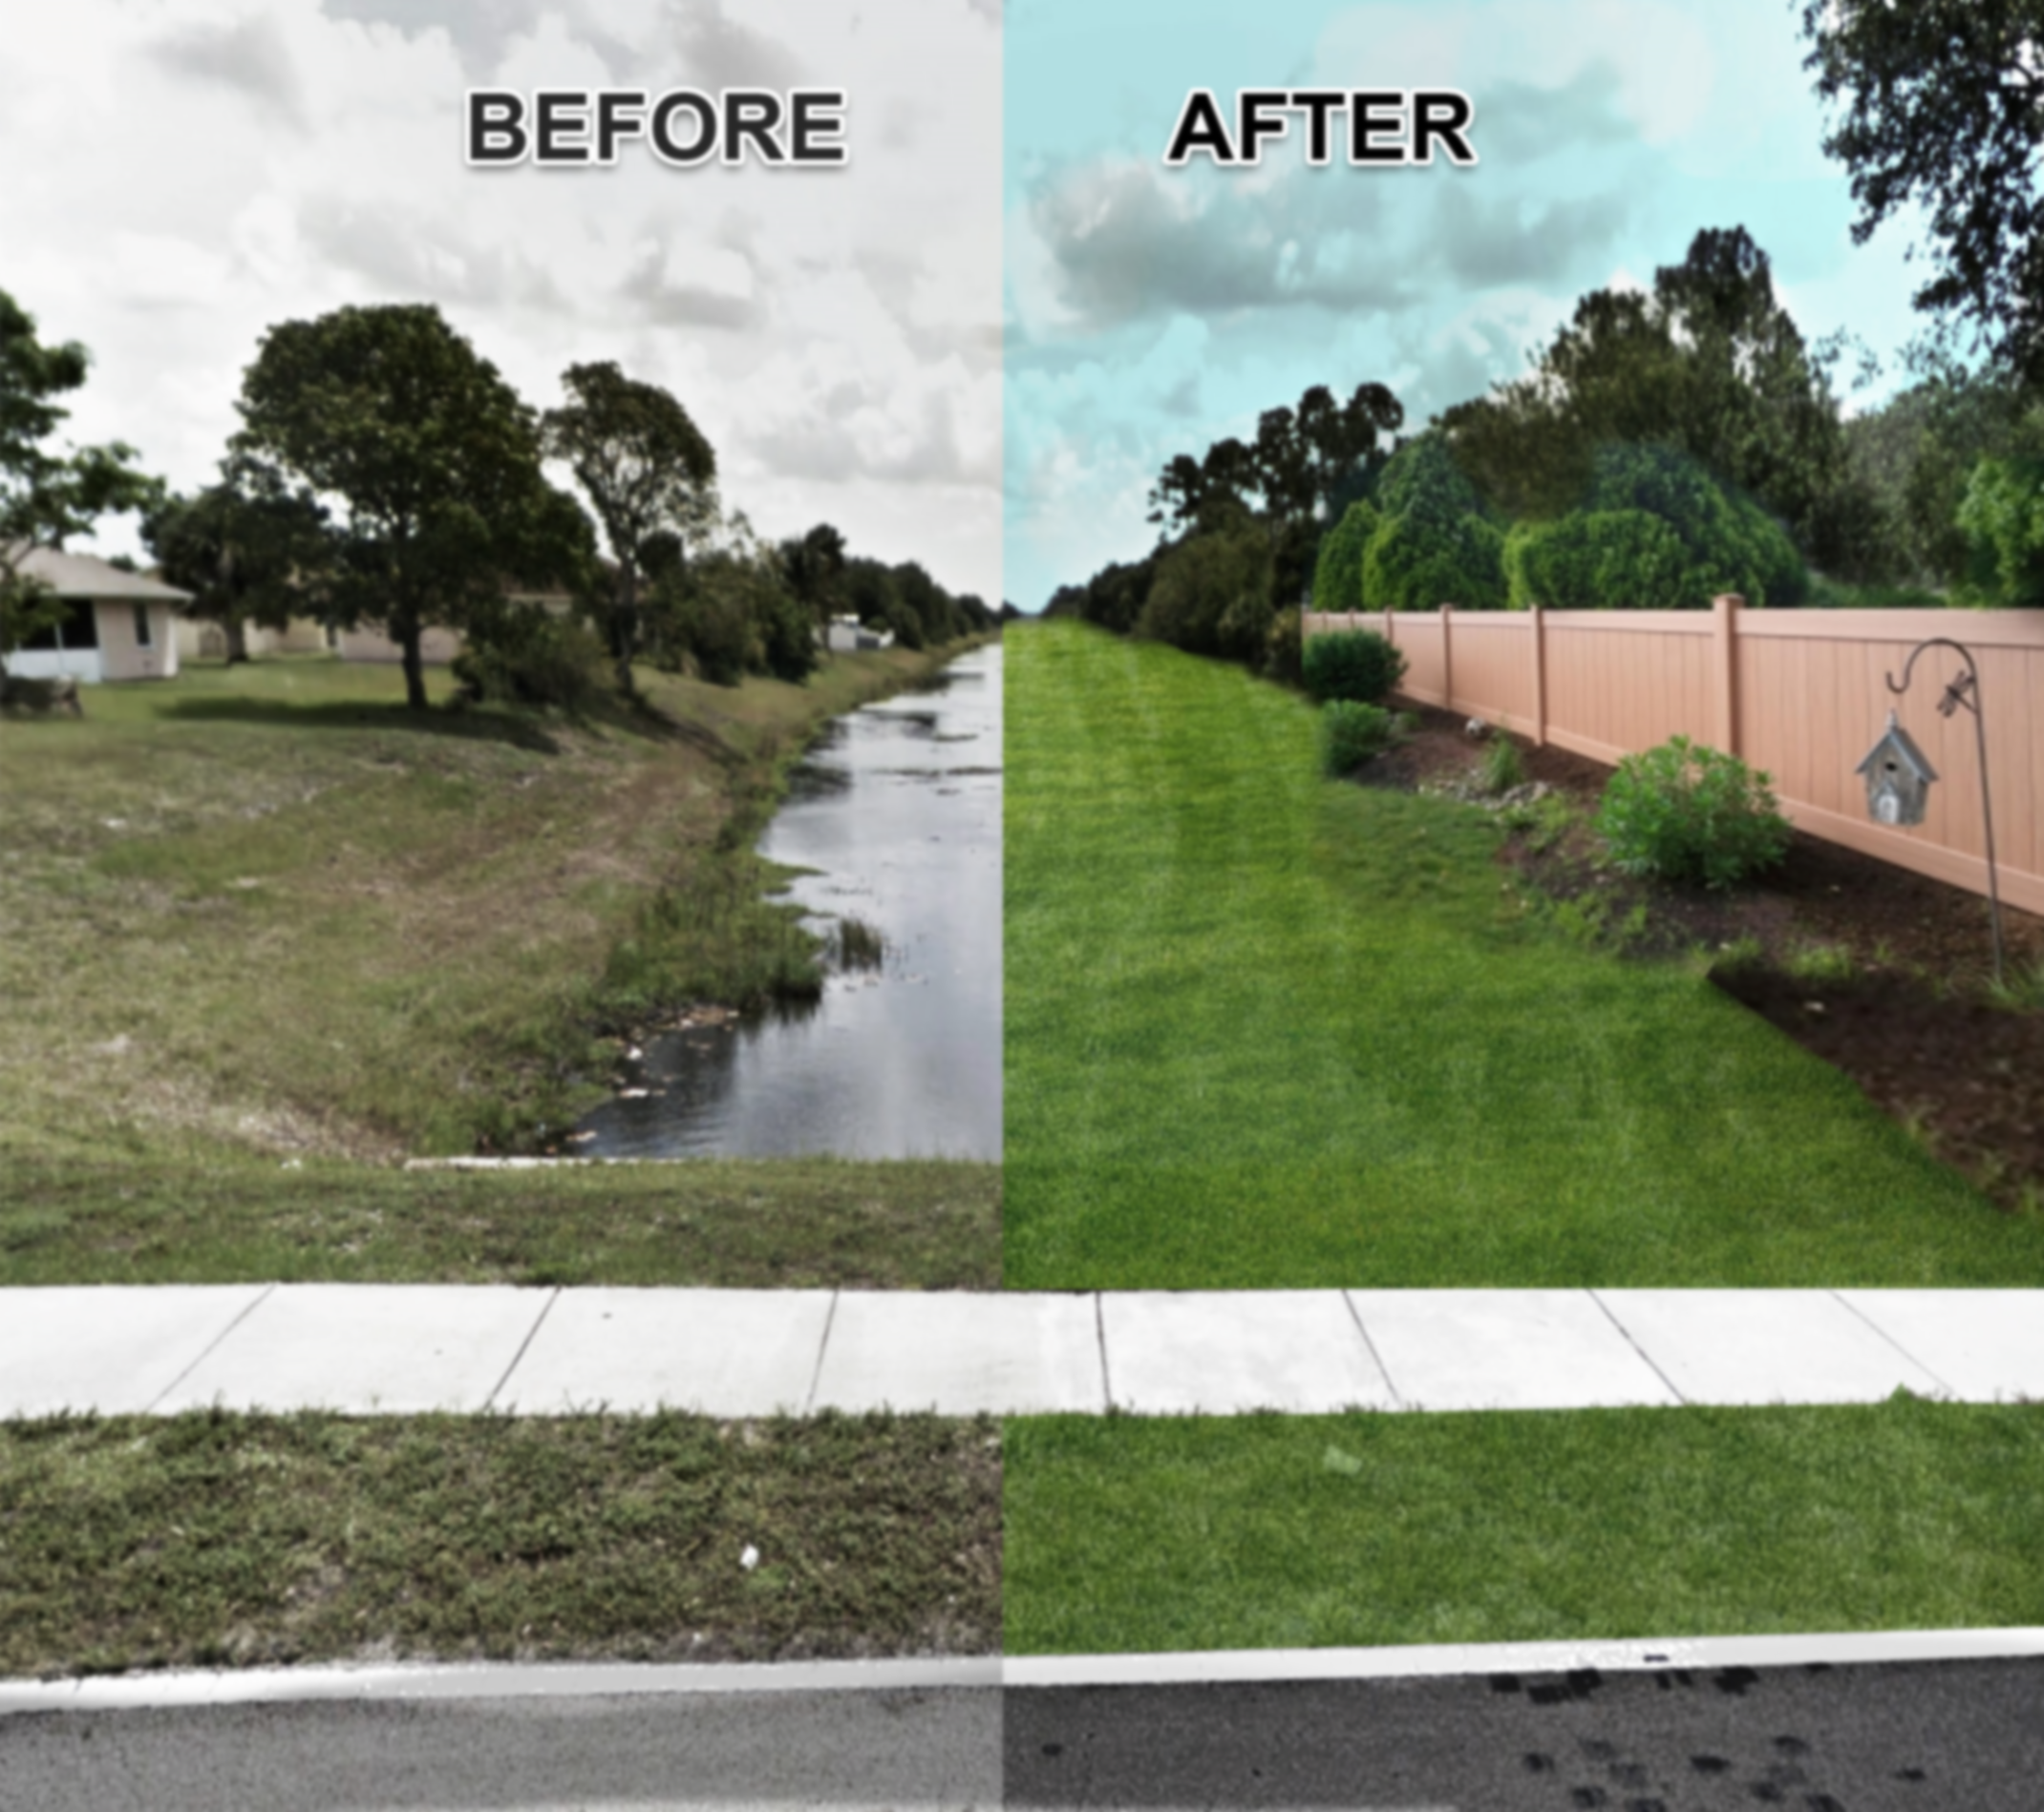
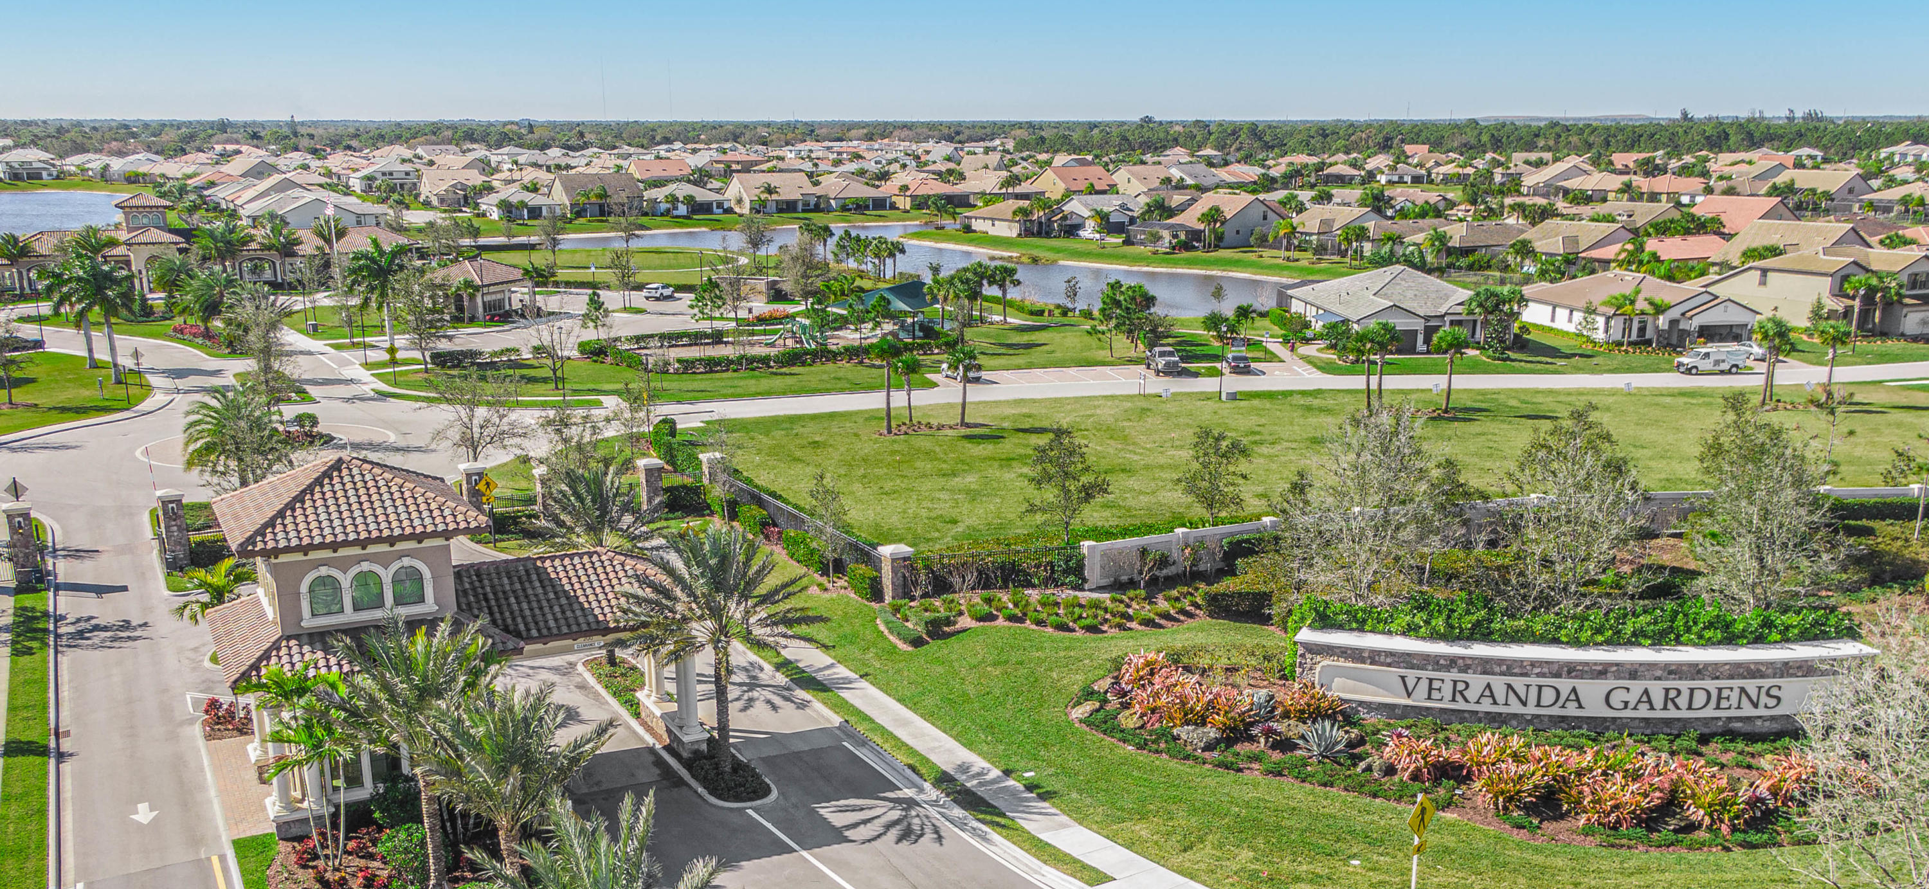

VERANDA CDD II
STORMWATER WORKSHOP
November 1, 2023 | 03:00pm

Slide 2

TEAM PRESENT
Name | Role
Brian Mendes | District Manager
Brennan Dwyer | CDD Board Liaison
Roberto Cabrera, PE | District Engineer
Kinan Husainy, PE | Engineer of Record (VPE, VPW, VE)
Kelly Cranford, PE | Subject Matter Expert

Slide 3
TODAY’S ACTIVITIES
Overview of Veranda CDD II Stormwater Management System (10 mins)
Ongoing Items – Veranda Preserve & Q/A (40 mins)
Ongoing Items – Veranda Gardens East & Q/A (40 mins)
Florida Stormwater Design Overview & Q/A (30 mins)

Slide 4
STORMWATER MANAGEMENT OVERVIEW
Our stormwater management system covers ±600 acres of residential development and includes:
±55 acres of surface water in 23 lakes
3 irrigation lakes
2 ultimate outfall control structures
± 13,000 LF piped lake interconnections
±20 acres of wetlands / conservation
The system provides water quality treatment and storm attenuation.

Slide 5
STORMWATER MANAGEMENT OVERVIEW
Veranda CDD is comprised of five (5) residential projects
  Veranda Preserve West
  Veranda Preserve East
  Veranda Estates
  Veranda Oaks
  Veranda Gardens East
Each project is a self contained, closed basin
  Individual Water Management District Permit
  Unique design elements (i.e. Design elevations, control elevation, discharge amount, etc)
Stormwater Main Outfall is via two (2) different outfalls
  North Outfall – Veranda Preserve East & West, Veranda Estates, Veranda Oaks
  South Outfall – Veranda Gardens East & Veranda Gardens West (CDD I)

Slide 6
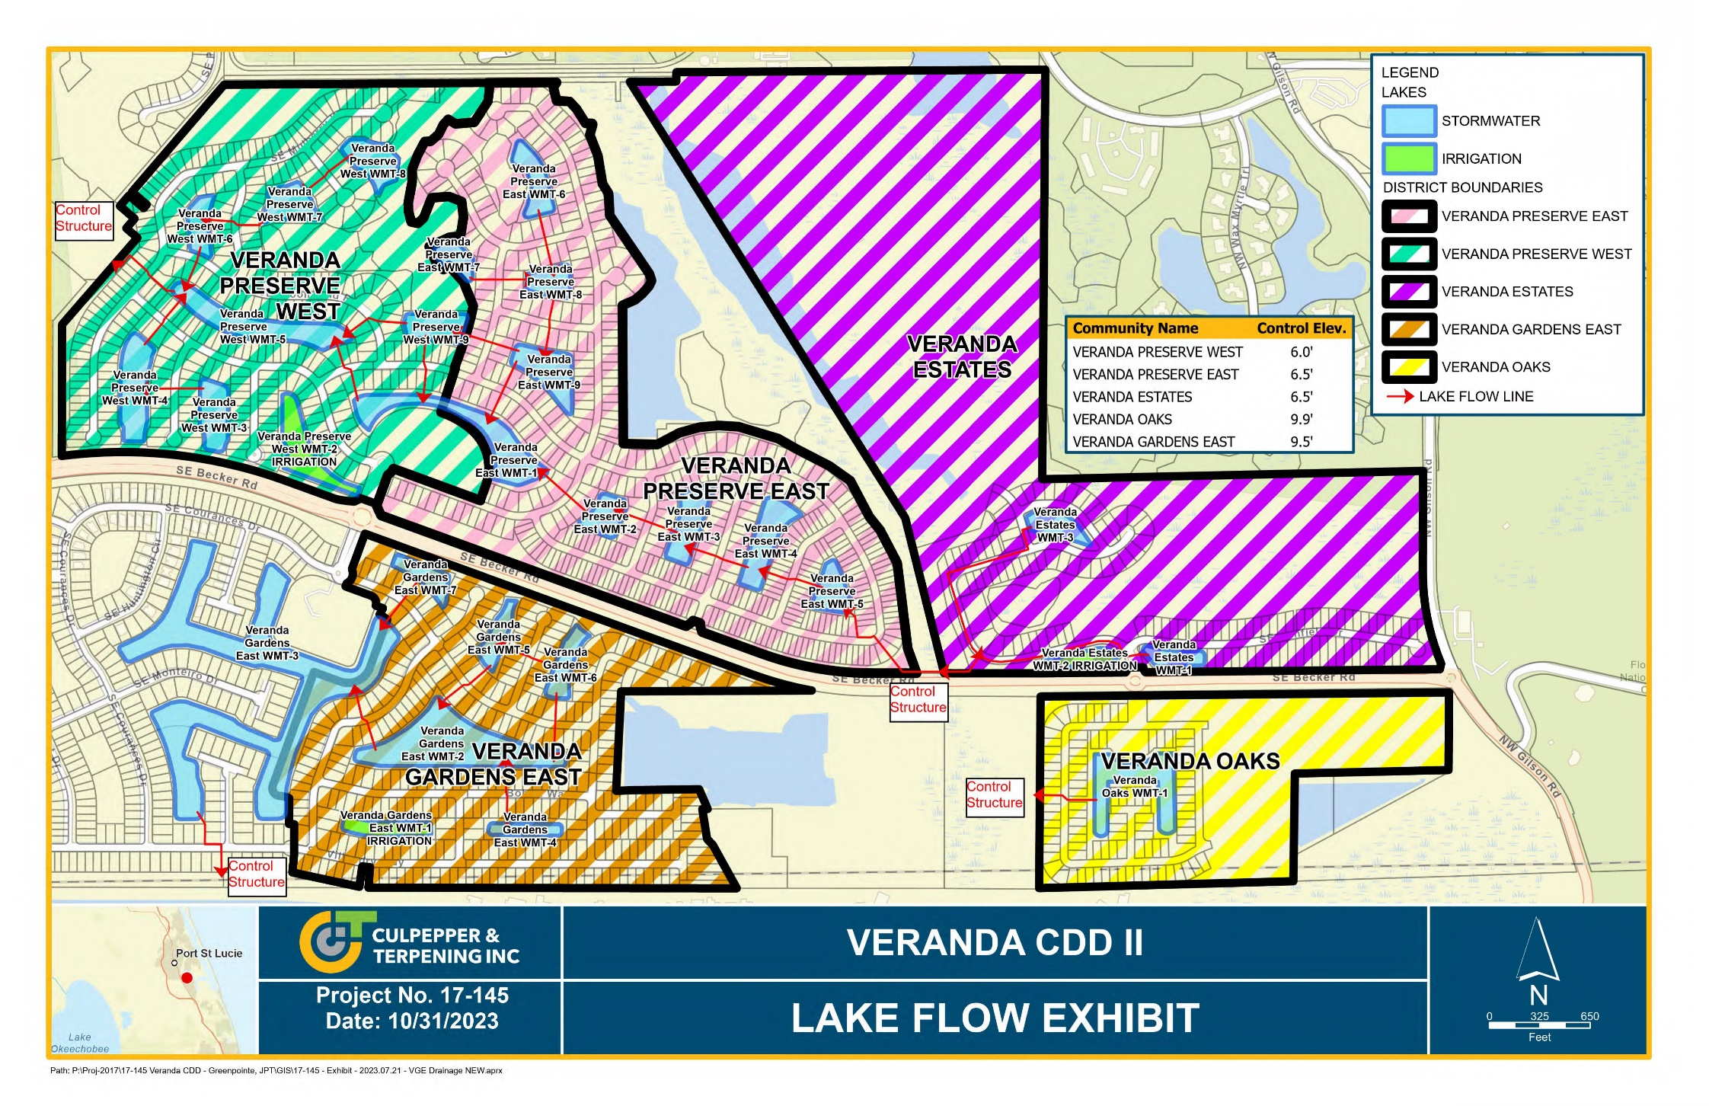

Slide 7
STORMWATER MANAGEMENT OVERVIEW
Veranda Preserve West (112.53 acres)
Design Element | Design Parameter | Rainfall Amount | Permitted Value
Roadway Conveyance | 3-year | 4.0” | N/A
Roadway Crown | 10-year, 1-day | 6.0” | 8.42’ NAVD
Discharge Rate | 25-year, 3-day | 10.0” | 81.51’ CFS 36,584 GPM
Perimeter Berm | 25-year, 3-day | 10.0” | 9.50’ NAVD
Finished Floor Elevation | 100-year, 3-day | 11.0” | 10.59’ NAVD
Control Elevation | N/A | N/A | 6.5’ NAVD

Slide 8
STORMWATER MANAGEMENT OVERVIEW
Veranda Preserve East (196.85 acres)
Design Element | Design Parameter | Rainfall Amount | Permitted Value
Roadway Conveyance | 3-year | 4.0” | N/A
Roadway Crown | 10-year, 1-day | 6.0” | 8.42’ NAVD
Discharge Rate | 25-year, 3-day | 10.0” | 81.51’ CFS 36,584 GPM
Perimeter Berm | 25-year, 3-day | 10.0” | 9.50’ NAVD
Finished Floor Elevation | 100-year, 3-day | 11.0” | 10.59’ NAVD
Control Elevation | N/A | N/A | 6.5’ NAVD

Slide 9
STORMWATER MANAGEMENT OVERVIEW
Veranda Estates (79.11 acres)
Design Element | Design Parameter | Rainfall Amount | Permitted Value
Roadway Conveyance | 3-year | 4.0” | N/A
Roadway Crown | 10-year, 1-day | 6.0” | 8.94’ NAVD
Discharge Rate | 25-year, 3-day | 10.0” | 14.10 CFS 6,329 GPM
Perimeter Berm | 25-year, 3-day | 10.0” | 9.50’ NAVD
Finished Floor Elevation | 100-year, 3-day | 11.0” | 10.59’ NAVD
Control Elevation | N/A | N/A | 6.5’ NAVD

Slide 10
STORMWATER MANAGEMENT OVERVIEW
Veranda Oaks (55.79 acres)
Design Element | Design Parameter | Rainfall Amount | Permitted Value
Roadway Conveyance | 3-year | 4.0” | N/A
Roadway Crown | 10-year, 1-day | 6.5” | 12.88’ NAVD
Discharge Rate | 10-year, 5-day | 11.0” | 38.25 CFS 17,169 GPM
Perimeter Berm | 10-year, 5-day | 11.0” | 13.66’ NAVD
Finished Floor Elevation | 100-year, 3-day | 13.0” | 15.11’ NAVD
Control Elevation | N/A | N/A | 9.9’ NAVD

Slide 11
STORMWATER MANAGEMENT OVERVIEW
Veranda Gardens East (97.52 acres)
Design Element | Design Parameter | Rainfall Amount | Permitted Value
Roadway Conveyance | 3-year | 4.0” | N/A
Roadway Crown | 10-year, 1-day | 6.5” | 11.90’ NAVD
Discharge Rate | 10-year, 3-day | 9.0” | 12.00 CFS 5,386.32 GPM
Perimeter Berm | 25-year, 3-day | 10.2” | Basin 1: 13.00’ NAVD Basin 2: 13.50’ NAVD Basin 3: 13.80’ NAVD Basin 4: 12.80’ NAVD
Finished Floor Elevation | 100-year, 3-day | 12.9” | Basin 1, 3, 4: 14.50’ NAVD Basin 2: 14.56’ NAVD
Control Elevation | N/A | N/A | 9.5’ NAVD

Slide 12

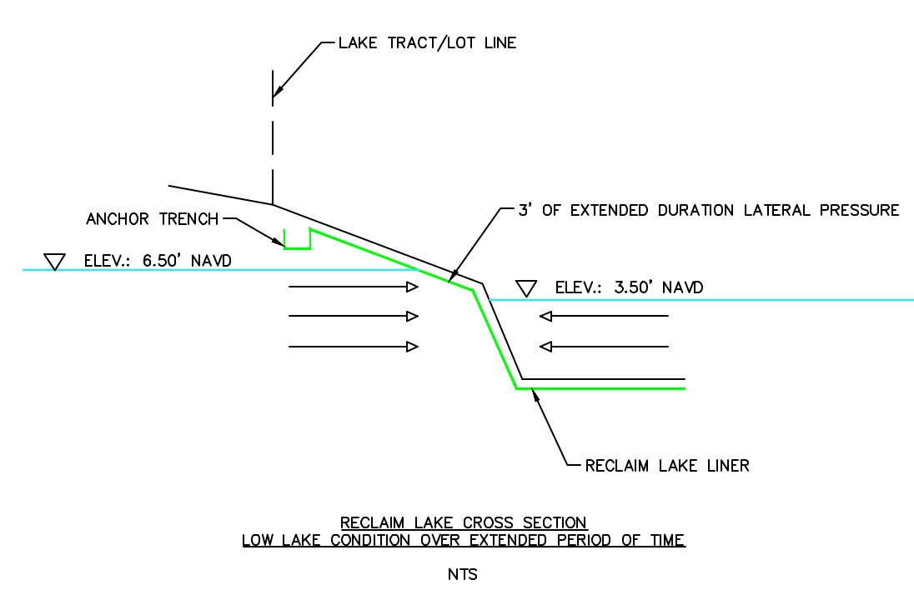
ONGOING ITEMS – VPW RECLAIM
Liner and bank is experiencing separation caused by different water table elevations
Reclaim Pond level has been kept low
Water Table has been high (rainy season)
Lateral Hydraulic pressure has caused failure

Slide 13
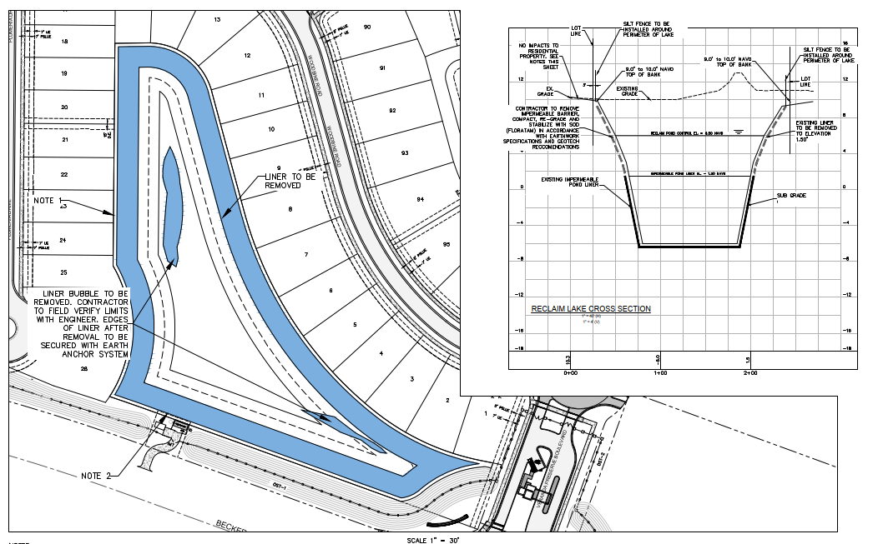
ONGOING ITEMS – VPW RECLAIM
Proposal to remove liner from Bank as shown below, and re-establish pond bank
Geotechnical Engineer is using field collected data to provide groundwater model to show no impacts to wetlands and surface water ponds
Upon completion, need to get approval from SFMWD, FDEP and City of PSL

Slide 14
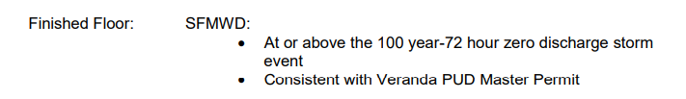

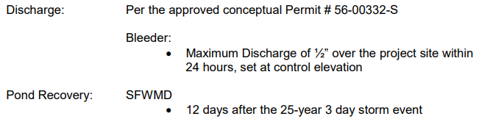
ONGOING ITEMS – VPW STORMWATER
Requirements:
Provide Treatment prior to discharge to eliminate pollutants downstream of project into sensitive receiving waters
Provide flood protection for the required design storm events
Limit Discharge to predevelopment conditions to not flood downstream
Provide system recovery

Slide 15
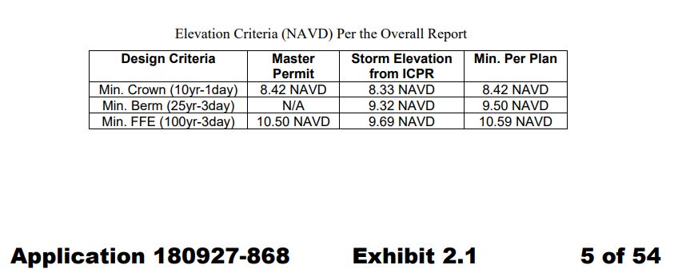
ONGOING ITEMS – VPW STORMWATER
Design:
Min Roadway Crown is set to the peak 10 yr – 24 Hr storm stage in ICPR. Set 1” above this to maintain drive-able path.
Min Finished Floor Elevation is set to +/- 1 foot above the modeled 100yr – 72 Hr storm peak stage, with ZERO Discharge

Slide 16
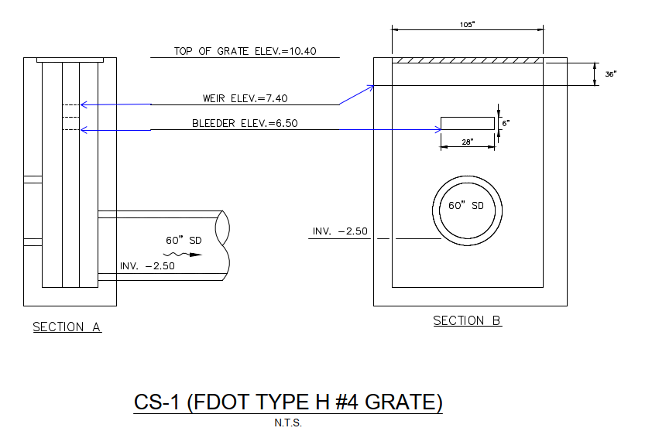
ONGOING ITEMS – VPW STORMWATER
Bleeder Elevation is set based on groundwater elev. at peak (wet weather months) based on
geotechnical report.
Weir Elev. is set at required treatment elevation
Discharge is set per the master permit for this site. Control structure is designed to limit
to allowable limits while providing flood protection

Slide 17
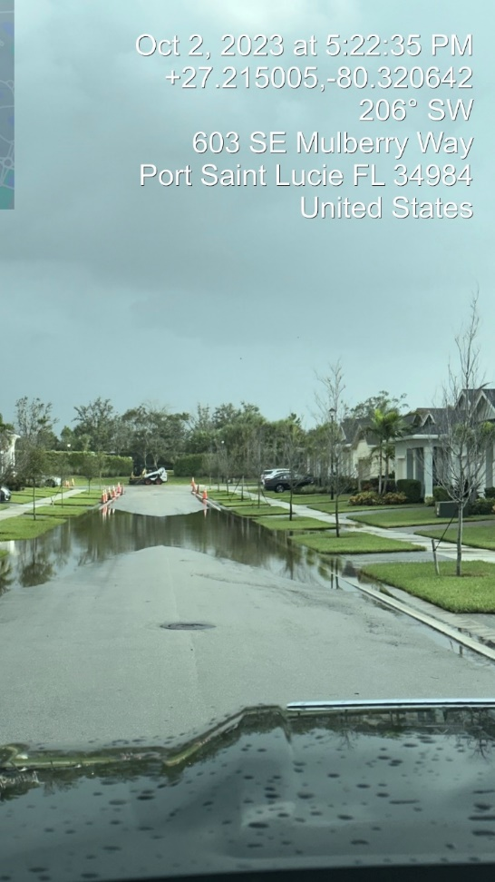
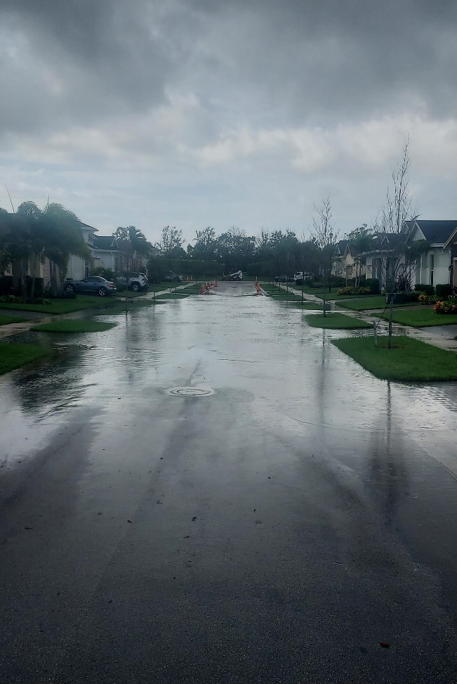
ONGOING ITEMS – VPW STORMWATER
Local Reports of 10” to 11” of Rain over a 24 Hour period, with additional rain
24 hours before and after
Recovered to below grate elevation within 24 Hours of rain ending

Slide 18
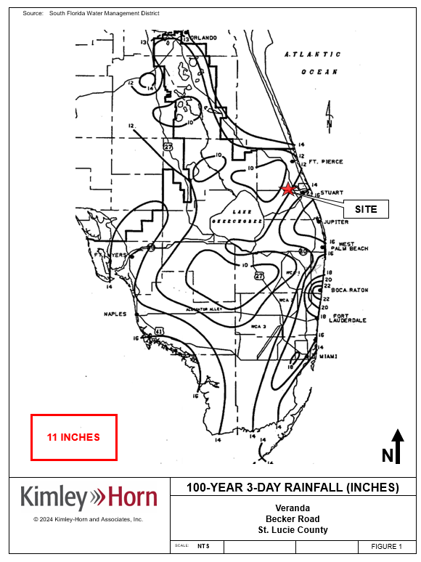
ONGOING ITEMS – VPW STORMWATER
Veranda Preserve West – Storm Event September 28th – October 1st
100 Yr 72 HR Rainfall Map

Slide 19
ONGOING ITEMS – VPW STORMWATER
THANK YOU FOR LISTENING
QUESTIONS

Slide 20
ONGOING ITEMS – VGE STORMWATER
Ongoing System Improvements
  Outfall Maintenance
  Final Lift Asphalt
  SD-23A Structure Modification (Emergency Overflow)

Slide 21
ONGOING ITEMS – VGE STORMWATER
Outfall Maintenance
  Shared outfall located along the C-23 canal
  Vegetative overgrowth reducing system recovery
  Impacts all of VGE lakes
  On 10-02-2023 measured 5” higher prior to cleanup
Coordination w/ Veranda CDD 1
Coordination w/ SFWMD
  ROW Permit

Slide 22
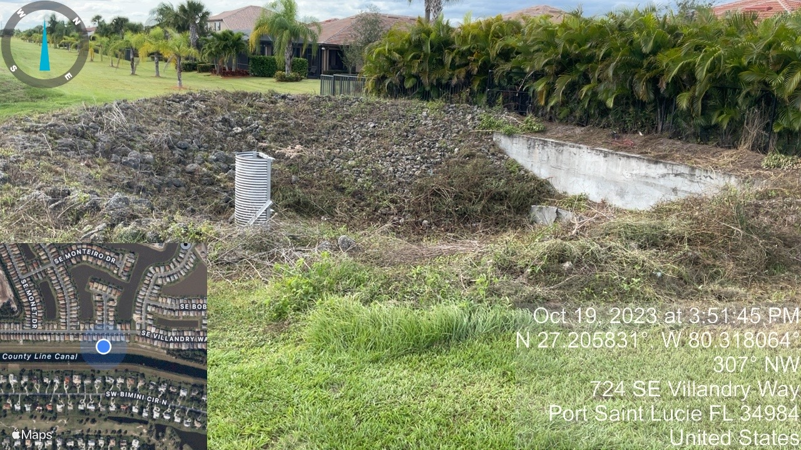
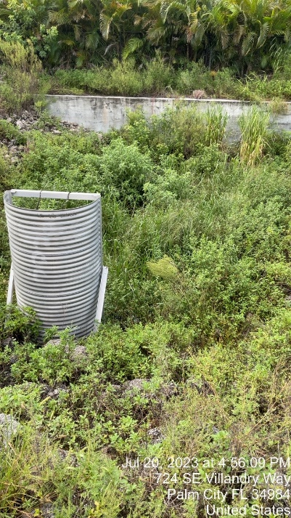
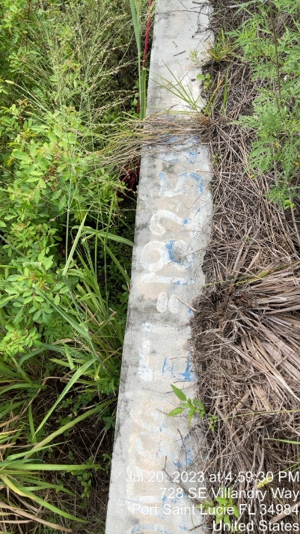
ONGOING ITEMS – VGE STORMWATER
Hand clearing of all vegetation
Spraying to remove all vegetation
Recommendation of regular maintenance
BEFORE
AFTER

Slide 23
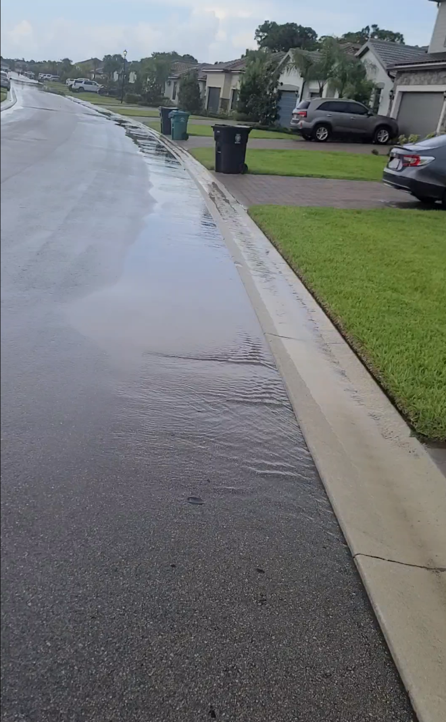
ONGOING ITEMS – VGE STORMWATER
Final Lift of Asphalt
  Will route stormwater into the correct drainage structure.
  Impacts all of VGE drainage system, but greatest impact if preventing hydraulic overload of system low points
  Example: Villandry Way and Butchart St
  1” of water across a 12’ lane has a cross sectional area greater than a 12” drain pipe.
  Consistent with original permitted design
Inlet
Bypass

Slide 24
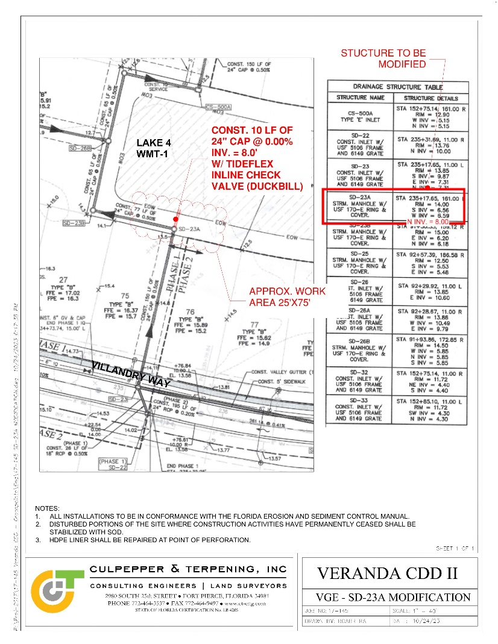
ONGOING ITEMS – VGE STORMWATER
SD-23A Structure Modification
  Construct Emergency Relief (one-directional) outfall into Lake 4
  Bid solicited from Contractor
  Direct relief to Villandry Way during intense storm events

Slide 25
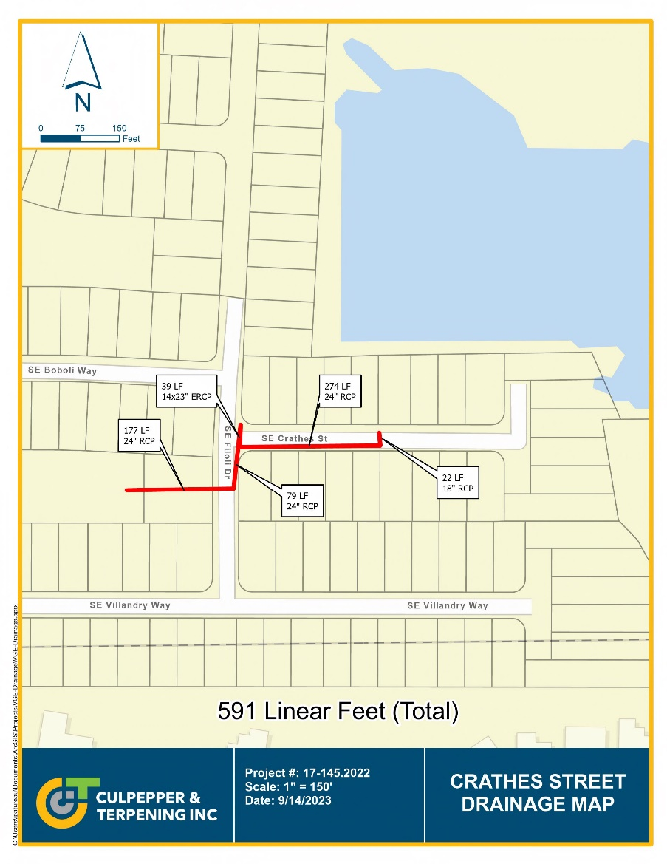
ONGOING ITEMS – VGE STORMWATER
Crathes Street
  Will benefit from outfall maintenance and final lift of asphalt
  Ongoing Drainage Investigation
  Televising inspection is pending
  Additional relief will be evaluated if televising does not demonstrate system blockage

Slide 26
ONGOING ITEMS – VGE STORMWATER
THANK YOU FOR LISTENING
QUESTIONS

Slide 27
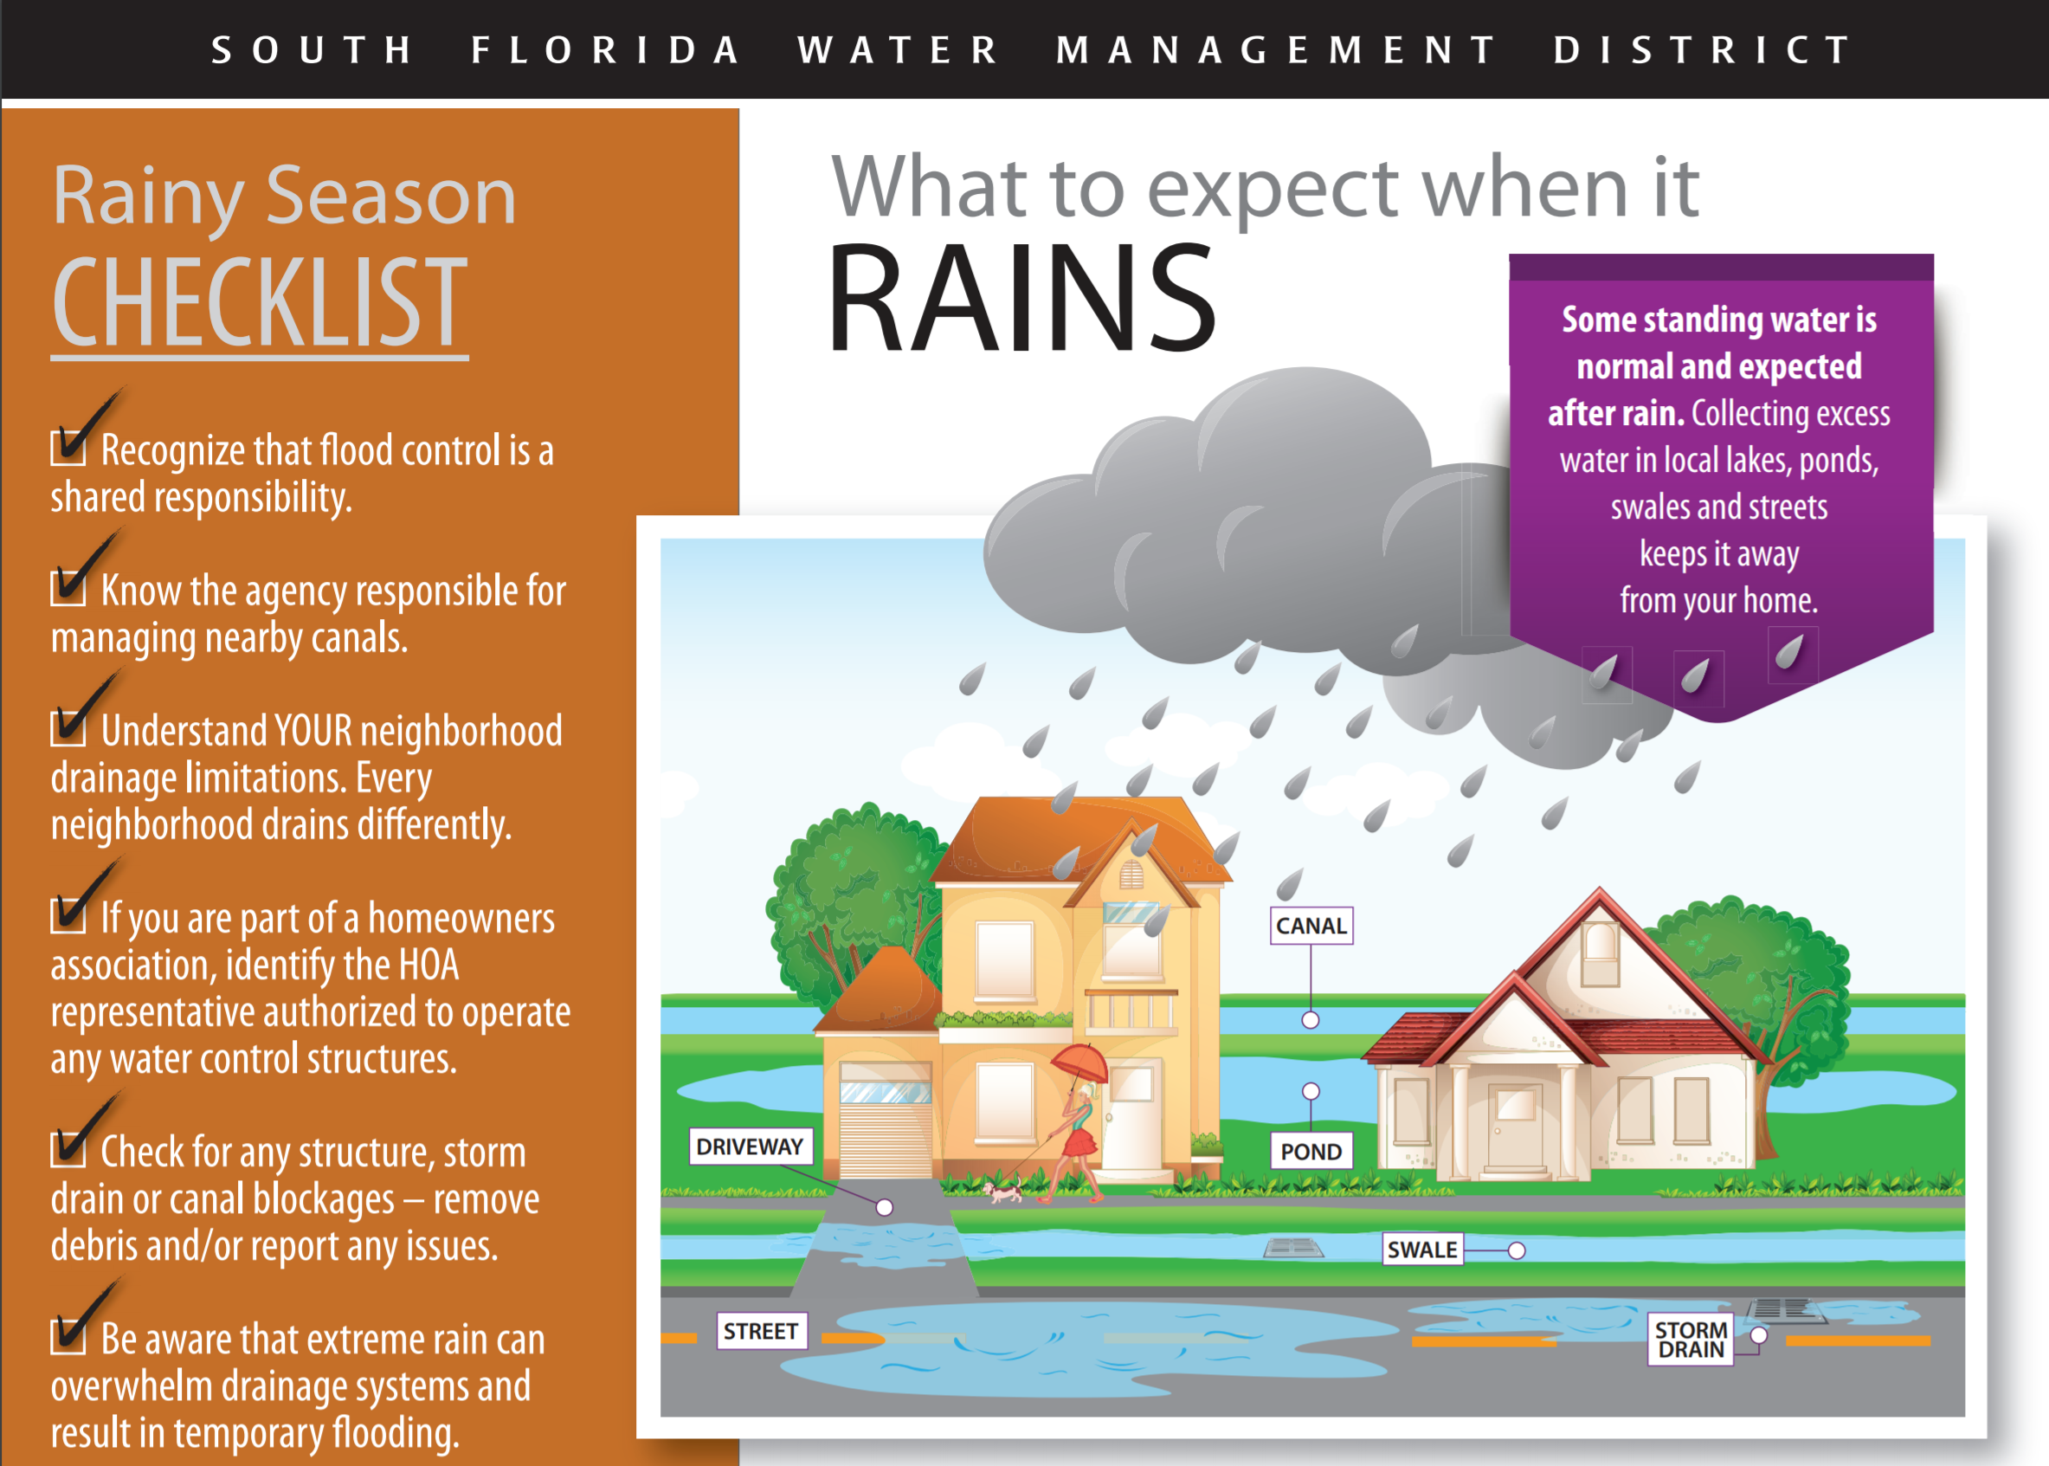
WHAT TO EXPECT WHEN IT RAINS

Slide 28
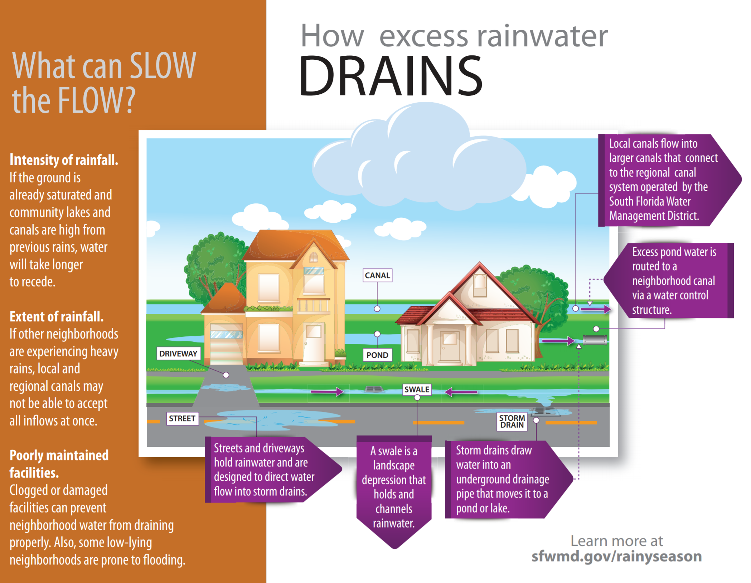
WHAT TO EXPECT WHEN IT RAINS

Slide 29
HOW IS THE SYSTEM MAINTAINED?
Rainy season (June through October):
Keep water levels in lakes at or slightly above control elevation
Make sure drainage grates, ditches and swales are clear of debris
Check community lakes/ponds for obstructed pipes
Perform post rainfall inspections to verify proper system performance
Dry season (November through May):
Perform routine maintenance (outfall clearing and spraying)
Keep water levels in lakes above control elevation when possible

Slide 30
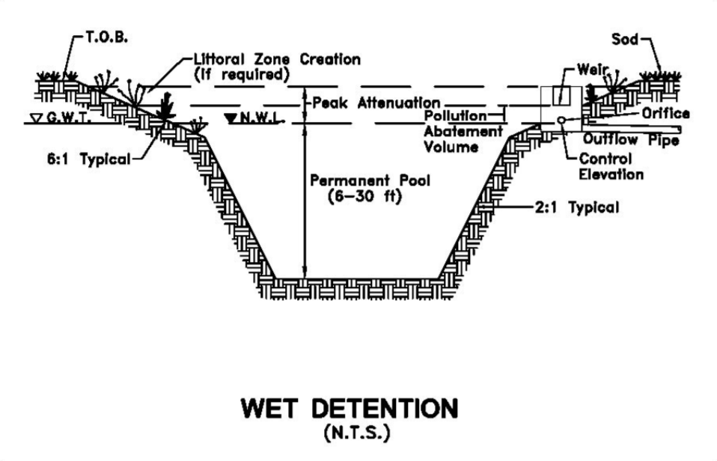
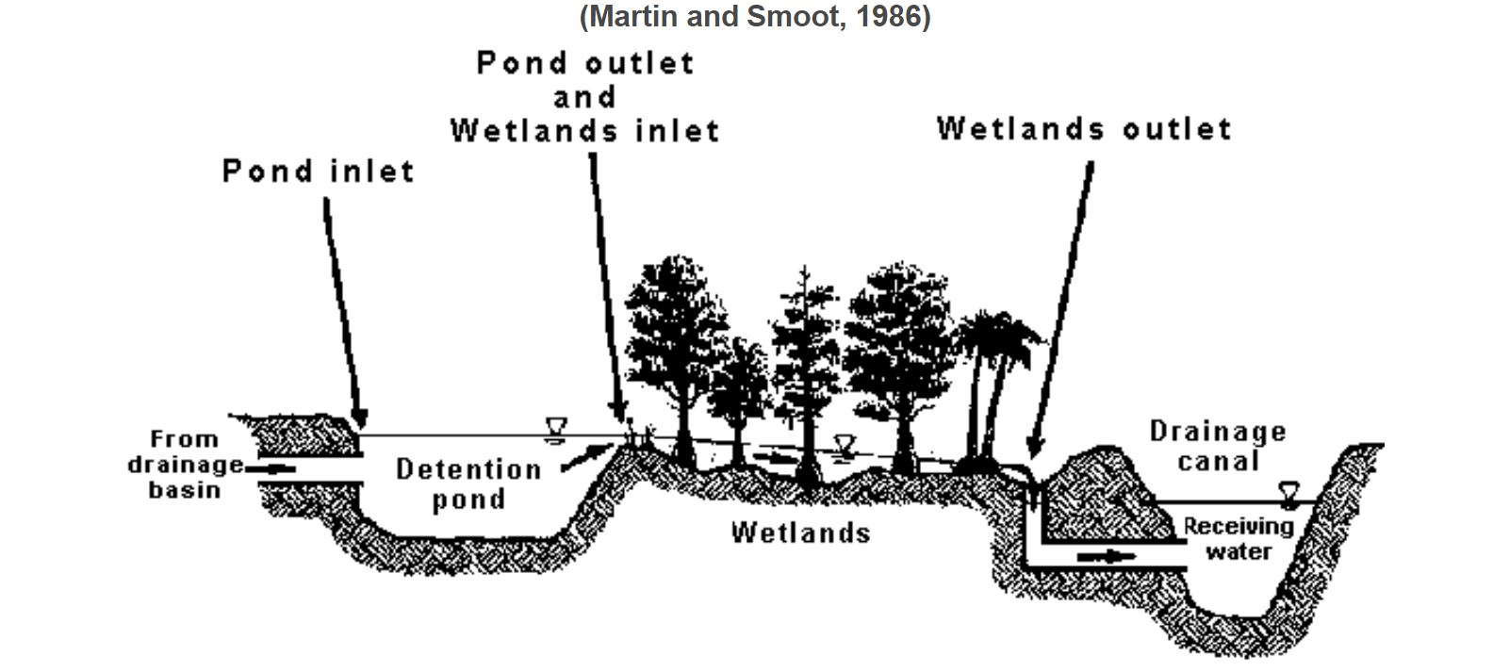
HOW IS THE SYSTEM MAINTAINED?
What is a control elevation? The lowest elevation at which water can be released through the control structure. Often a bleeder as small as 3-inches in width or diameter.
How is the control elevation established?
Wetland protection elevations,
Consistency with water use permits,
Consistency with water tables and surrounding projects,
Maximum of six feet below natural ground.

Slide 31
WHO IS RESPONSIBLE FOR MAINTENANCE?
CDD:
Lakes below control elevation and control structures (after they are completed and accepted by CDD)
Pipes connecting lakes (after being accepted by CDD)
Canals (after being accepted by CDD)
HOA:
Lake banks above control elevation
Roadway drainage (may be responsibility of City if they have accepted roadway)

Slide 32
WHAT SHOULD I EXPECT WHEN IT RAINS?
Moderate Rain (4 to 6 inches in 24 hour period):
Standing water in yards, swales, and ditches
Standing water in roadways, but one car width of roadway should be passable, typically near center of road
Heavy Rain (7 to 10 inches in 72 hour period):
Roads, swales, ditches, and yards are flooded
Buildings should stay dry
Stay home!
Torrential Rain (10 to 20 inches in 72 hour period):
Some houses and businesses will flood. Prepare for the worst case.
Stay off the roads. Evacuate if advised by Emergency Management to do so.

Slide 33
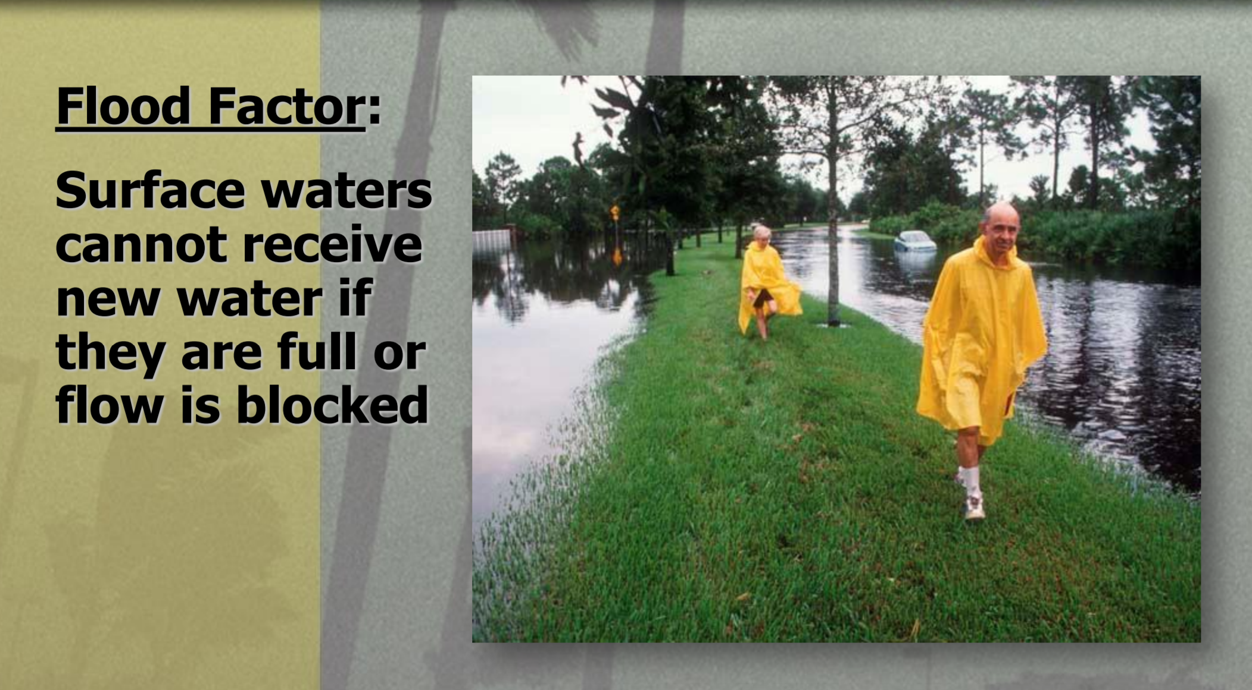
WHAT SHOULD I EXPECT WHEN IT RAINS?

Slide 34
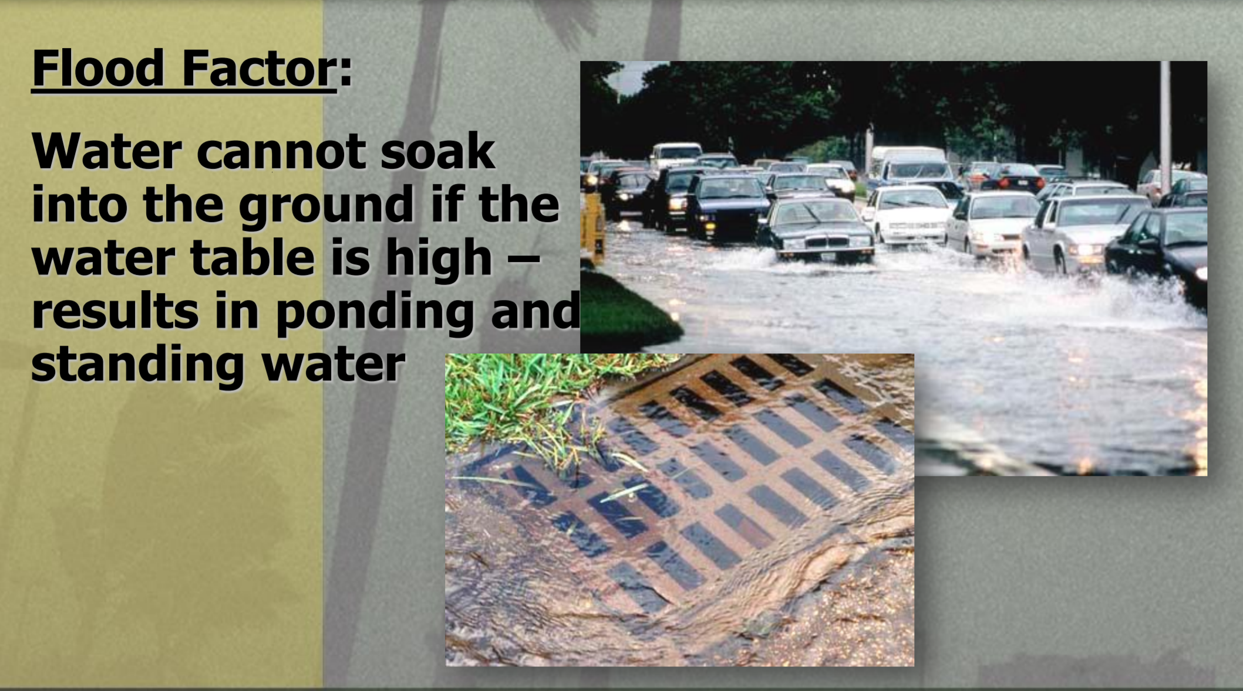
WHAT SHOULD I EXPECT WHEN IT RAINS?

Slide 35
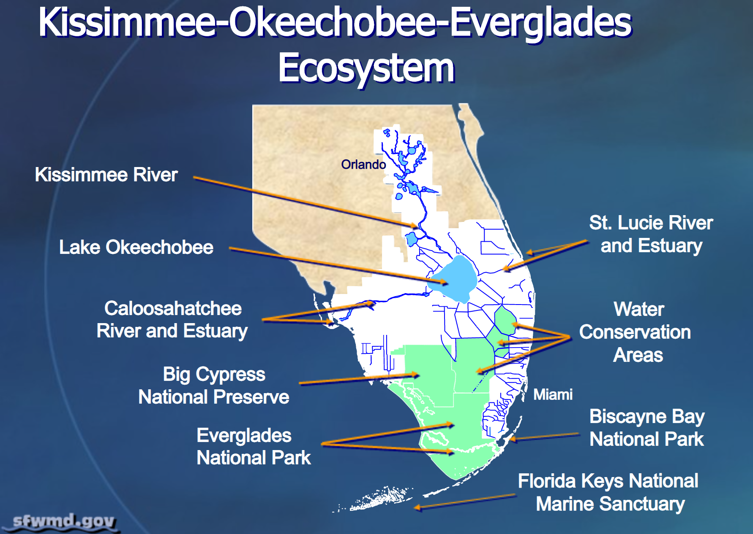
SOUTH FLORIDA ECOSYSTEM

Slide 36
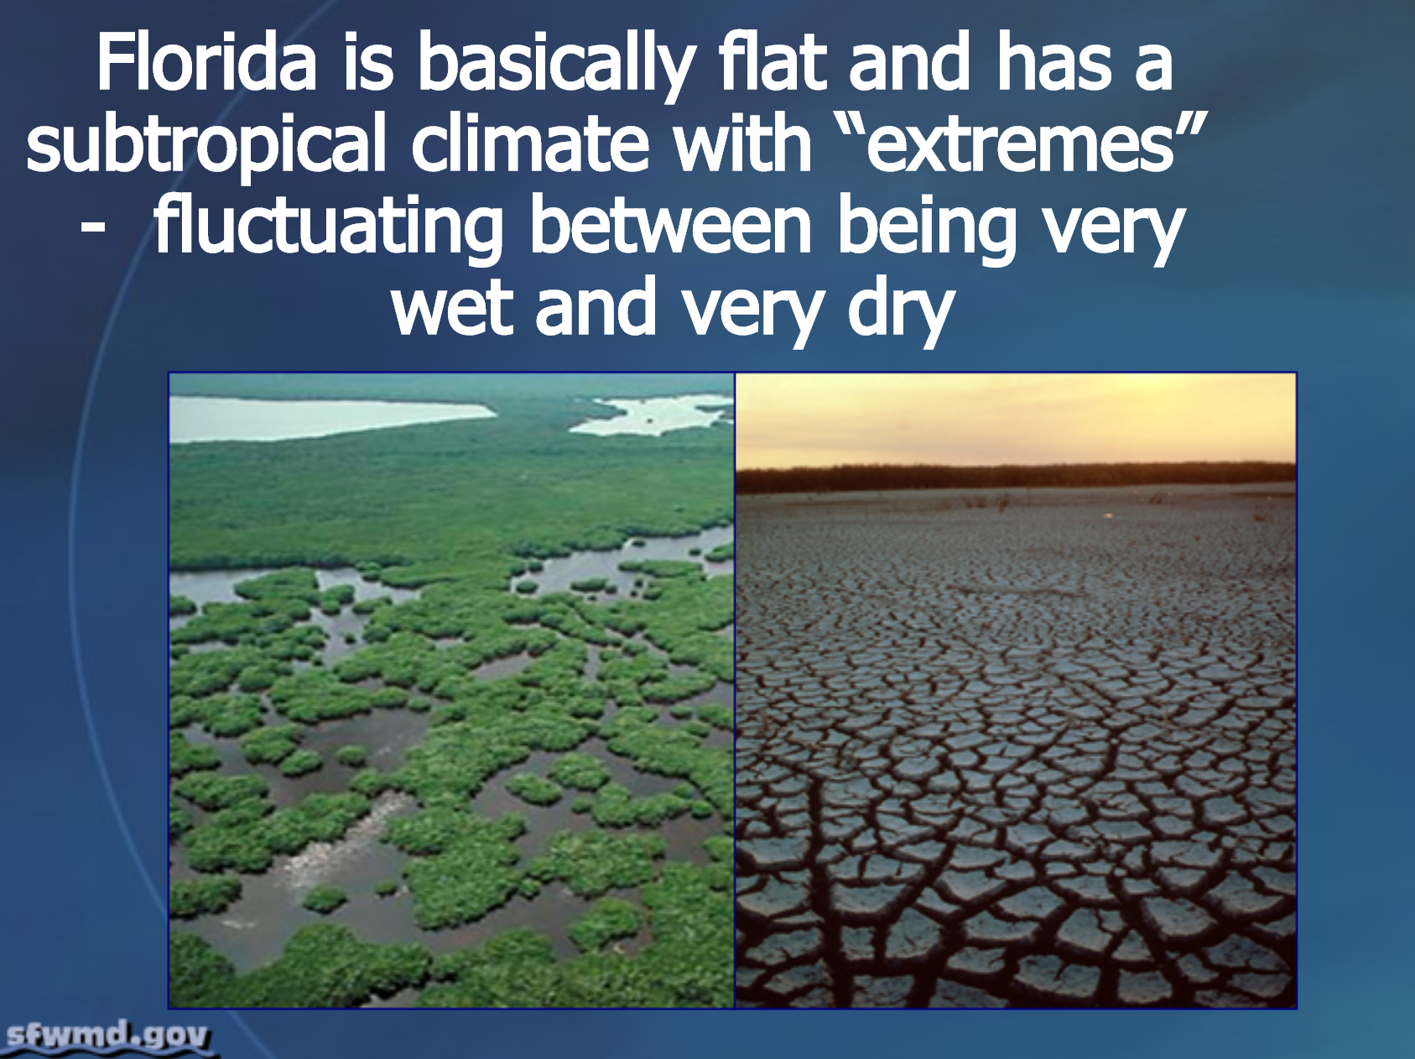
SOUTH FLORIDA ECOSYSTEM

Slide 37
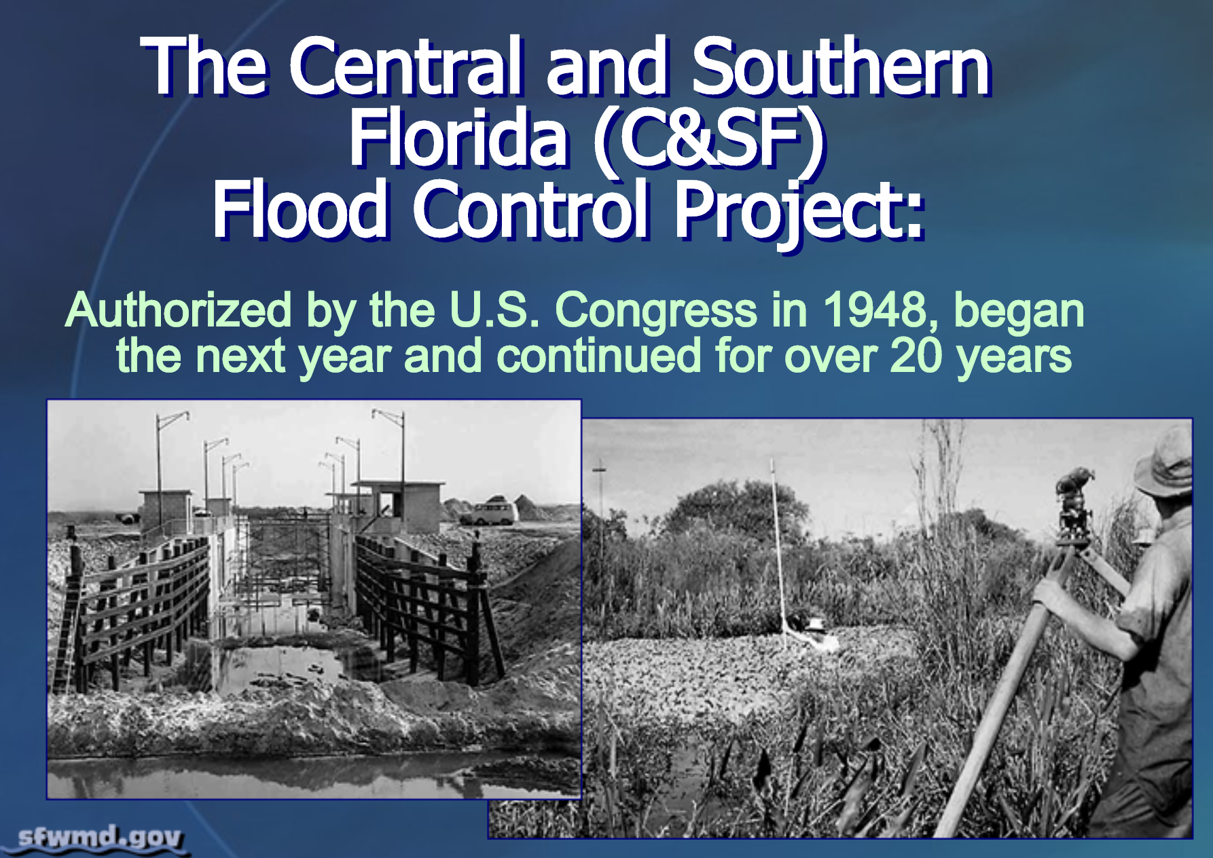
SOUTH FLORIDA ECOSYSTEM

Slide 38
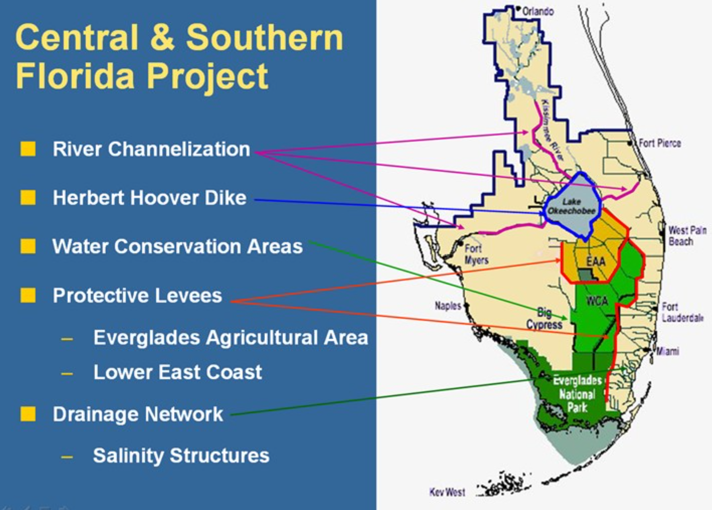
SOUTH FLORIDA ECOSYSTEM

Slide 39
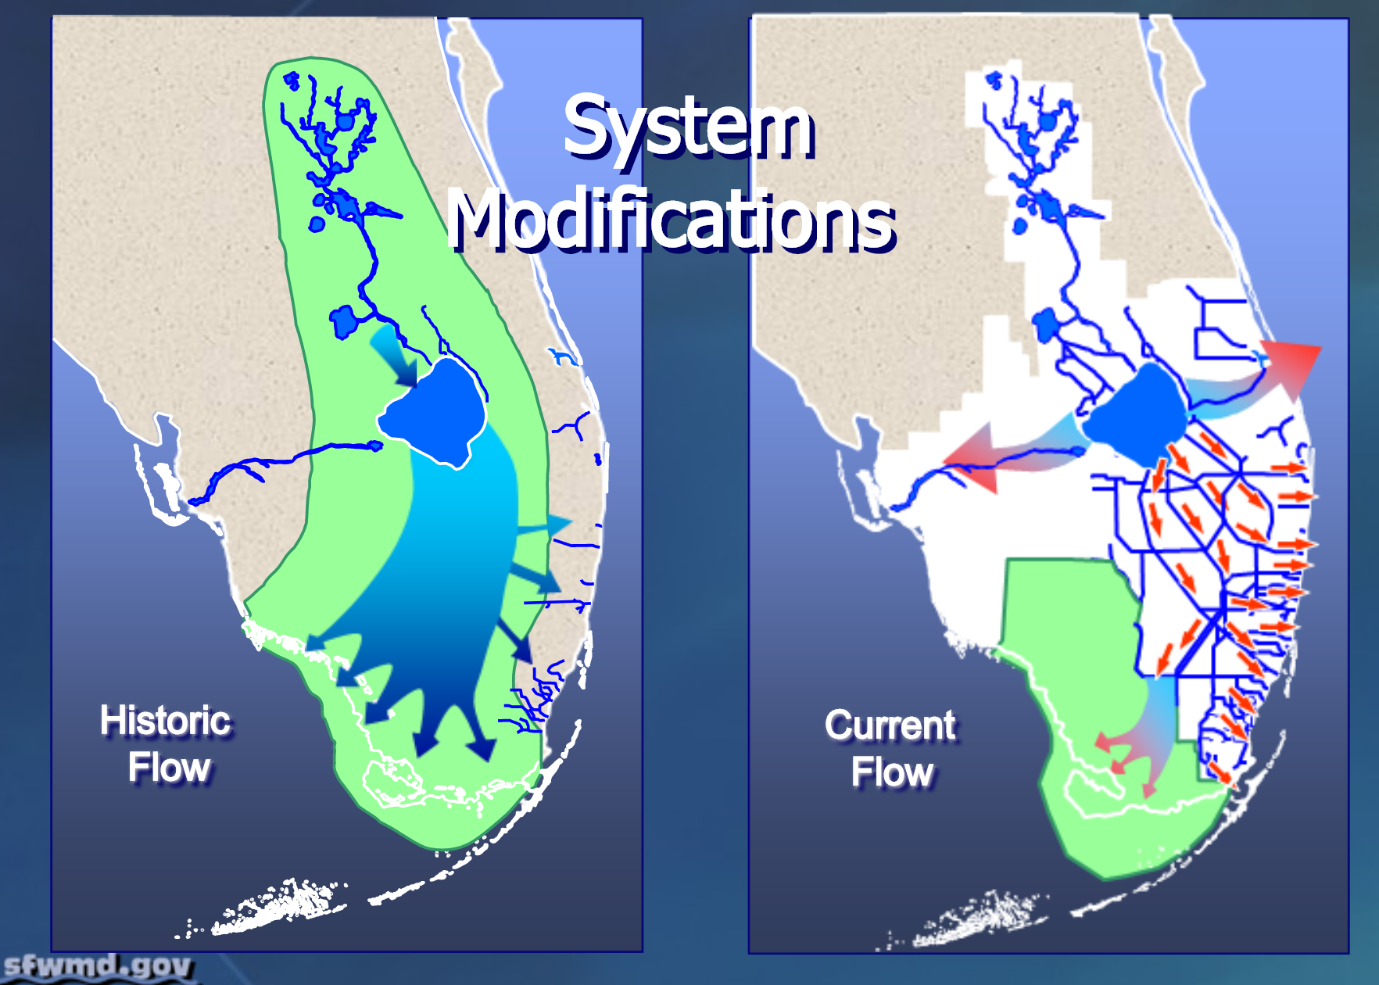
SOUTH FLORIDA ECOSYSTEM

Slide 40
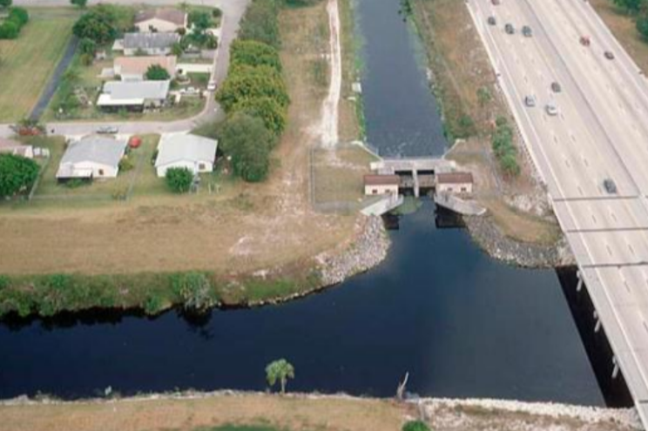
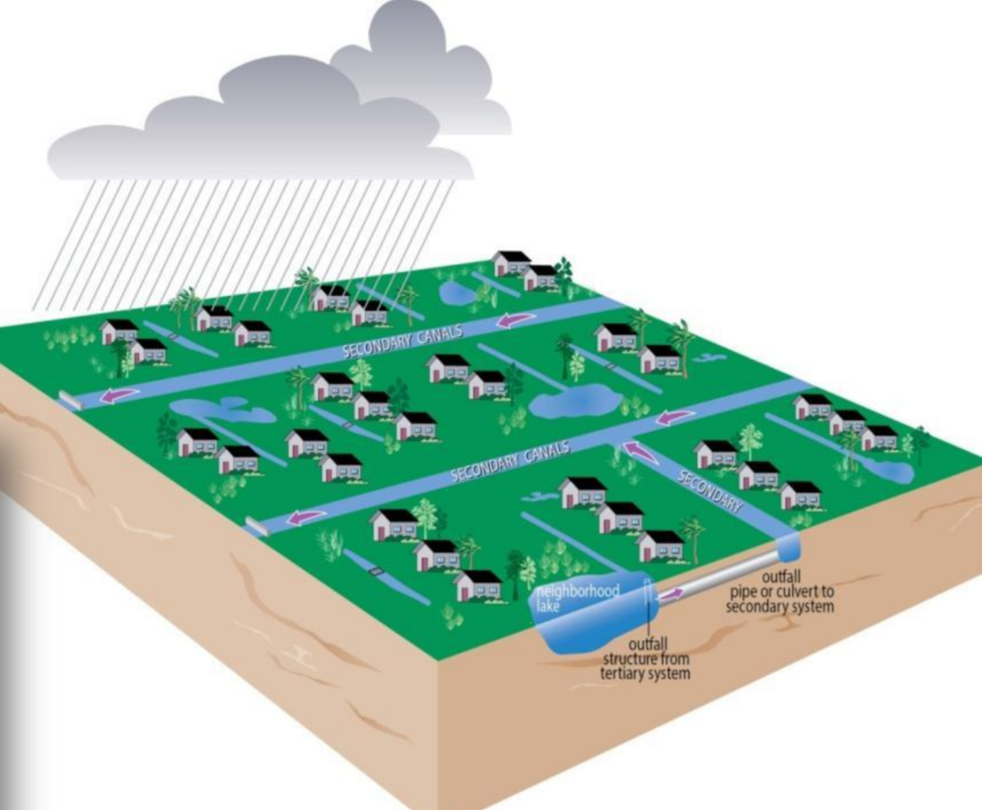
SOUTH FLORIDA DRAINAGE

Slide 41
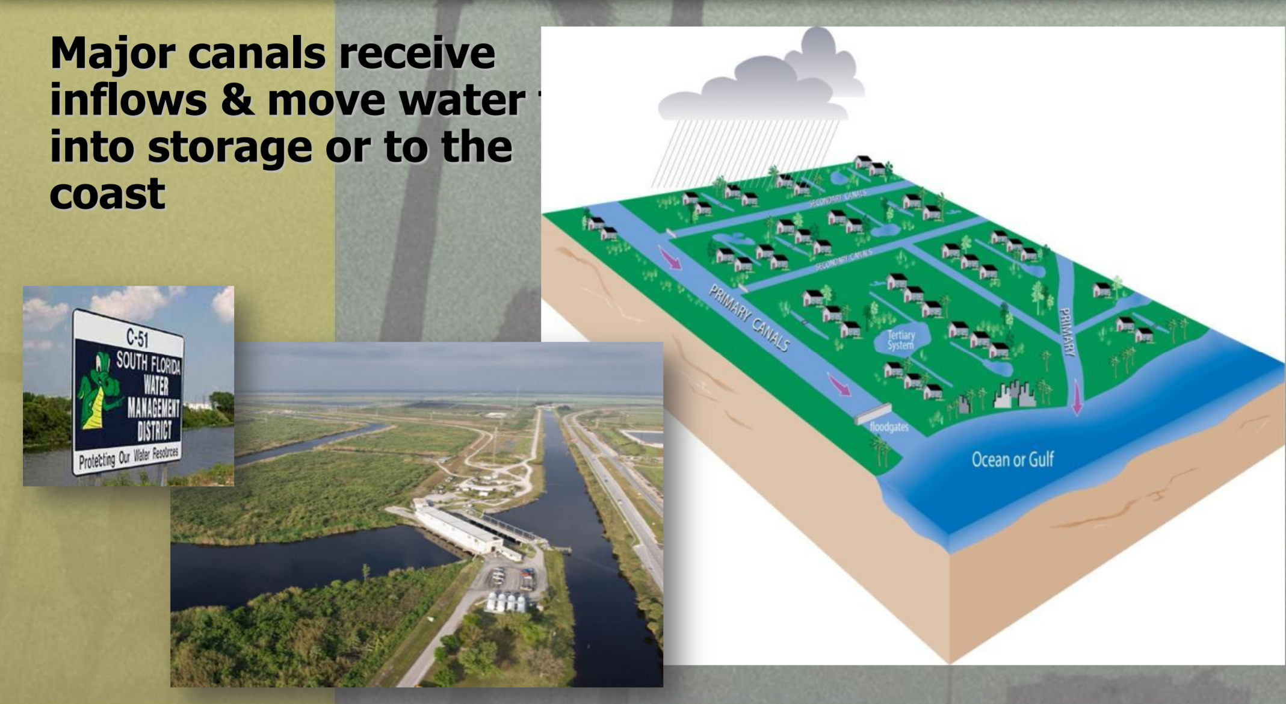
SOUTH FLORIDA DRAINAGE

Slide 42
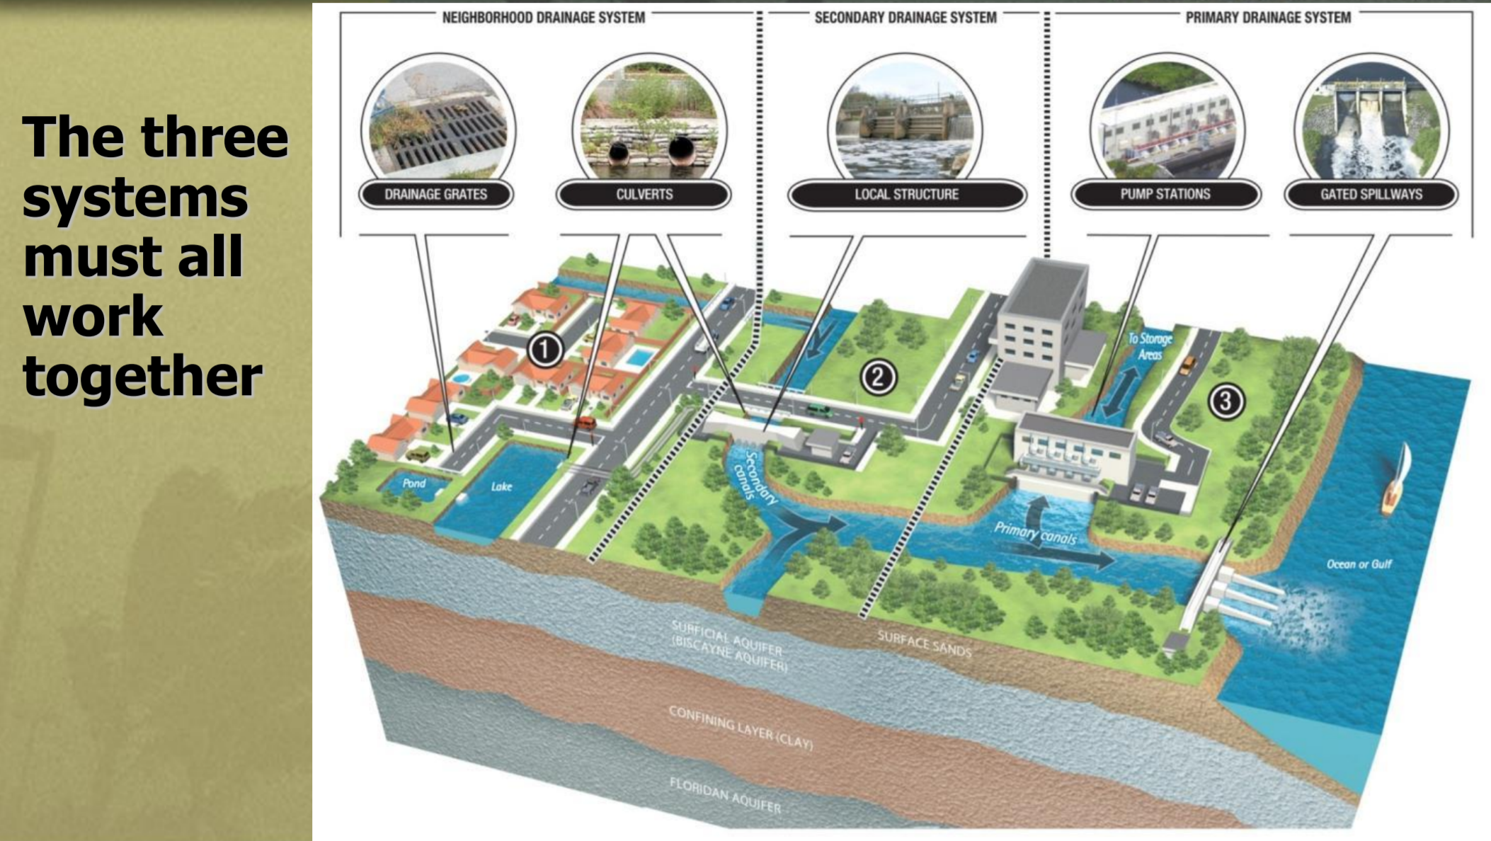
SOUTH FLORIDA DRAINAGE

Slide 43
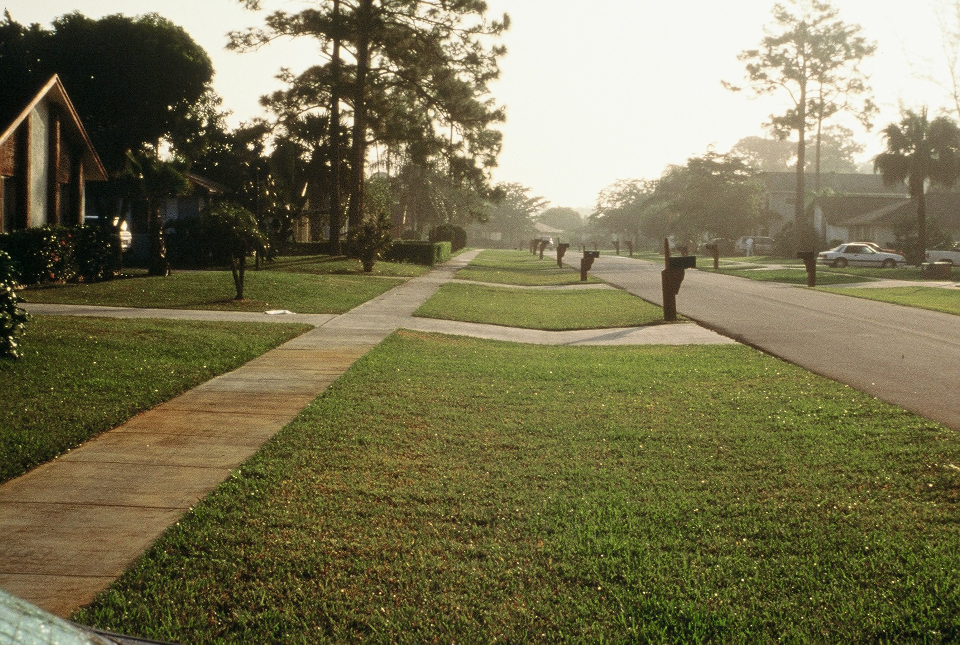
VERANDA CDD II STORMWATER SYSTEM
Swales
Inlets & pipes
Ditches
Dry retention/detention areas
Wet retention/detention areas (lakes)
Wetlands / conservation areas
Outfall structures

Slide 44
VERANDA CDD II STORMWATER SYSTEM
Studies in Florida have determined that the first 1” of runoff (rain) generally carries 90% of the pollution.

Slide 45
VERANDA CDD II STORMWATER SYSTEM
What kind of pollution are we talking about?
Sediment
Excessive Nutrients
Heavy metals
Petroleum hydrocarbons
Coliform bacteria

Slide 46
WHY DO WE NEED SO MANY LAKES?
We live in former low lying areas and are surrounded by swamp land. Lakes provide water quality treatment
Lakes provide flood protection
Lakes aid with water conservation
Lakes help with environmental preservation
They are required by Florida Statues

Slide 47
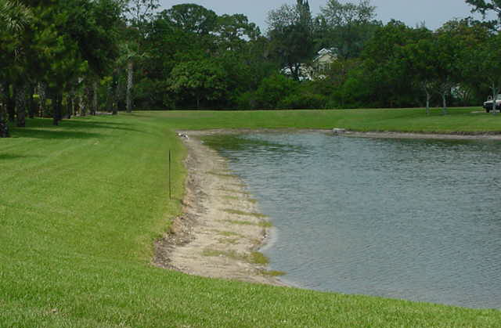
VERANDA CDD II STORMWATER SYSTEM
Seasonal Pond Fluctuations
Normal Seasonal
Water Table
Fluctuations

Slide 48
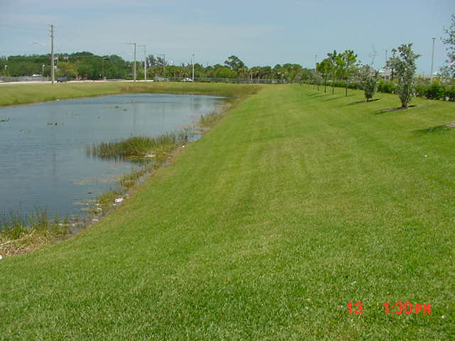
VERANDA CDD II STORMWATER SYSTEM
Water Management Easement
20’ Lake
Maintenance
Easement

Slide 49
FLORIDA STORMWATER DESIGN
THANK YOU FOR LISTENING
QUESTIONS

